Slide 1
PARCC Update
Mathematics
NCSM Presentation
April 25, 2012
Carrie Piper
Senior Adviser, PARCC Mathematics
Achieve
Notes:
Doug Sovde, Director, PARCC Instructional Supports and Educator Engagement
Twianie Roberts, Senior Associate, PARCC Mathematics

Slide 2
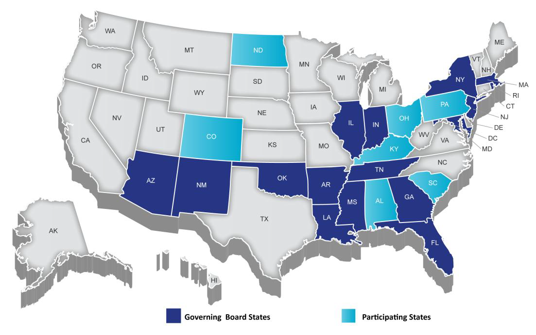

Partnership for Assessment of Readiness for College and Careers (PARCC)
Governing Board States
Participating States
Notes:
PARCC is an alliance of 24 states
Educating nearly 25 million students
Working together to develop a common set of K-12 assessments in English and math anchored in what it takes to be ready for college and careers.
PARCC is led by 16 governing board states (and D.C.) represented in Dark Blue.
CLICK: The chair of the governing board is Mitchell Chester, Education Commissioner of Massachusetts
CLICK: The state of Florida is serving as its fiscal agent.
CLICK: Achieve is the project manager for PARCC.

Slide 3



PARCC Assessment System
2 Optional Assessments/Flexible Administration
Diagnostic Assessment
Early indicator of student knowledge and skills to inform instruction, supports, and PD
Non-summative
Mid-Year Assessment
Performance-based
Emphasis on hard-to-measure standards
Potentially summative
Performance-Based
Assessment (PBA)
Extended tasks
Applications of concepts and skills
Required
End-of-Year
Assessment
Innovative, computer-based items
Required
Speaking And Listening
Assessment
Locally scored
Non-summative, required
Notes:
The system includes a suite of assessments and tools that, taken together, provide a more complete picture of student mastery of standards and progress throughout the year than is currently available on state assessments.
The PARCC assessment system will:
Reflect the sophisticated knowledge and skills found in the English and math Common Core State Standards
Include a mix of item types (e.g., short answer, richer multiple choice, longer open response, performance-based)
Make significant use of technology
Include testing at key points throughout the year to give teachers, parents and students better information about whether students are on track or need additional support in particular areas
Diagnostic Assessments
The diagnostic assessment in math will help educators understand the extent to which students have mastered the key ideas in mathematics ("highlighted domains") in order to pinpoint areas needing improvement or identify areas in which students are excelling. In addition, it will provide greater detail about students who are above and below grade level so teachers can individualize instruction
Timeline: Expected Summer/Fall 2014

Slide 4
PARCC Timeline Through 2011-2012
PARCC Tools & Resources
Model Content Frameworks released
(Nov 2011)
Educator Leader Cadres launched
Item & task prototypes released
Fall
2011
Winter
2012
Spring
2012
Summer
2012
Fall
2012
Updated Model Content Frameworks Released
Item development begins
PARCC Assessment Implementation

Slide 5
Timeline Through First PARCC Administration in 2014-2015
PARCC Tools & Resources
Partnership Resource Center launched
Professional development modules released
K-2 Formative Tools Released
College-ready tools released
Diagnostic assessments released
Summative PARCC Assessments
Spring
2013
Summer
2013
Fall
2013
Winter
2014
Spring
2014
Summer
2014
Fall
2014
Winter
2015
Spring
2015
Pilot/field testing begins
Model Instructional Units Released
Expanded field testing of diagnostic assessment
Expanded field testing
Optional Diagnostic and Midyear PARCC Assessments
Standard Setting in Summer 2015
PARCC Assessment Implementation

Slide 6

Developing the PARCC Assessment System
Mathematics Focus

Slide 7
Key Advances of the Common Core Mathematics
MATHEMATICS
Focus, coherence and clarity: emphasis on key topics at each grade level and coherent progression across grades
Balance between procedural fluency and understanding of concepts and skills
Promote rigor through mathematical proficiencies that foster reasoning and understanding across discipline
ANCHORED IN COLLEGE AND CAREER READINESS
Notes:
MATHEMATICS (Pass out the 5 handouts)
Focus, coherence and clarity
Focus on key topics at each grade level
Coherent progressions across grade levels
Addresses long-heard criticism of mile-wide, inch-deep math curricula
Balance between procedural fluency and understanding of concepts and skills
Content standards require both conceptual understanding and procedural fluency
Mathematical proficiencies
Mathematical proficiencies students should develop (e.g., abstract reasoning, modeling, precision, perseverance, strategic use of tools, making arguments)
Using mathematics to understand a problem – even in new or unfamiliar contexts
Anchored in college and career readiness
Work that is being informed by these shifts: Model Content Frameworks, Prototypes, Item Development work

Slide 8
Claims Driving Design: Mathematics
Students are on-track or ready for college and careers
Students solve problems involving the major content for their grade level with connections to practices
Student demonstrate fluency in areas set forth in the Standards for Content in grades 3-6
Students solve problems involving the additional and supporting content for their grade level with connections to practices
Students express mathematical reasoning by constructing mathematical arguments and critiques
Students solve real world problems engaging particularly in the modeling practice
Notes:
The Claims that are driving the design of the PARCC Mathematics assessment:
Solve problems involving the major content
Solve problems involving the additional and supporting content
Express mathematical reasoning
Modeling
Demonstrating fluency
The next slide goes a bit more in depth for the purposes of the PARCC Mathematics assessment.

Slide 9
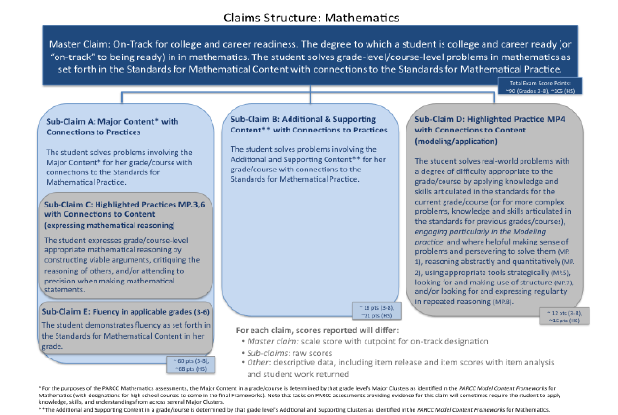
Claims Driving Design: Mathematics
Notes:
A better breakdown of the claims and how they relate to the design of the PARCC Mathematics assessment.
Note about Sub-Claim A: The Major Content in the grade/course is determined by that grade level’s Major Clusters as identified in the PARCC Model Content Frameworks for Mathematics. It is important to note that tasks on the PARCC assessments providing evidence for this claim will sometimes require the student to apply knowledge, skills, and understands from across several Major Clusters.
Note about Sub-Claim B: The additional and Supporting Content in a grade/course is determined by that grade level’s Additional and Supporting Clusters as identified in the PARCC Model Content Frameworks for Mathematics.

Slide 10
PARCC Model Content Frameworks

Slide 11
PARCC Model Content Frameworks
How familiar are you with the PARCC Model Content Frameworks for Mathematics?
Scale from 1-5
1: Little or No Knowledge
5: Expert

Slide 12
PARCC Model Content Frameworks
Purpose
Support implementation of the Common Core State Standards
Inform development of item specifications and blueprints for the PARCC assessments in grades 3–8 and high school
Audience
Primary audience is state and local curriculum directors
Frameworks will also be accessible for teachers and building administrators to use as a resource

Slide 13
PARCC Model Content Frameworks
Development Process
State-led process that included mathematics content experts in PARCC member states and members of the Common Core State Standards writing team
  Mathematics Rapid Response Feedback Group (content experts from a subset of PARCC states): Tommy Coy (AR), Gladys Cruz (NY), Robin Hill (KY), Rachel Jachino (IL), Mary Knuck (AZ), Barbara Libby (MA), Jim Mirabelli (IN), Brian Roget (OH), Carolyn Sessions (LA), John Svendsen (NY), Donna Watts (MD), Dee Ann Wilson (FL), Sandi Woodall (GA)
Three rounds of feedback; nearly 1,000 individual comments were submitted from K–12 educators, principals, superintendents, higher education faculty, school board members, parents, and students during the last public review

Slide 14
PARCC Model Content Frameworks
Approach of the Model Content Frameworks for Mathematics
PARCC Model Content Frameworks provide a deep analysis of the CCSS, leading to more guidance on how focus, coherence, content and practices all work together.
They focus on framing the critical advances in the standards:
  Focus and coherence
  Content knowledge, conceptual understanding, and expertise
  Content and mathematical practices
Model Content Frameworks for grades 3-8, Algebra I, Geometry, Algebra II, Mathematics I, Mathematics II, Mathematics III*
*High School Frameworks currently out for state-review

Slide 15
Key Elements of the Model Content Frameworks
Examples of key advances from the previous grade
Fluency expectations or examples of culminating standards
Examples of major within-grade dependencies
Examples of opportunities for connections among standards, clusters or domains
Examples of opportunities for in-depth focus
Examples of opportunities for connecting mathematical content and mathematical practices
Content emphases by cluster
Notes:
The Model Content Framework for Mathematics for each grade is written with the expectation that students develop content knowledge, conceptual understanding and expertise with the Standards for Mathematical Practice. A detailed description of all features of the standards would be significantly lengthier and denser. For that reason, the analyses given here are intended to be valuable starting points. The Model Content Frameworks for Mathematics provide guidance for grades 3–8 and high school across a number of areas…

Slide 16
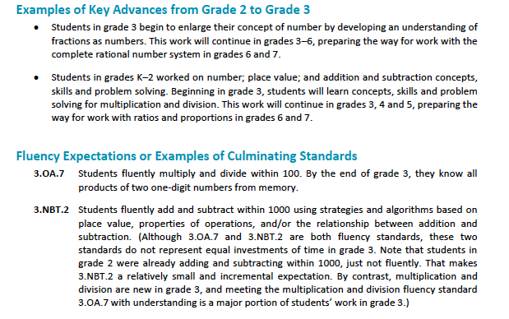
Grade 3 Example

Slide 17
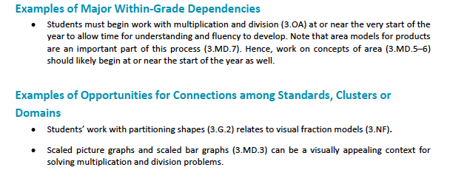
Grade 3 Example

Slide 18
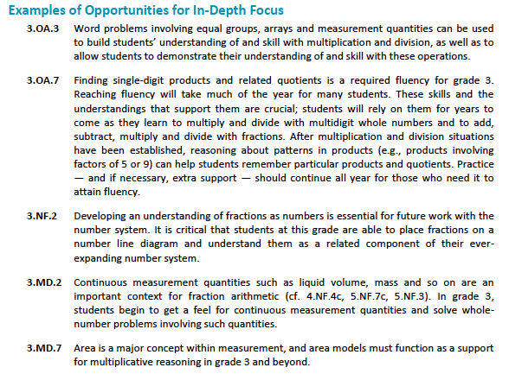
Grade 3 Example

Slide 19
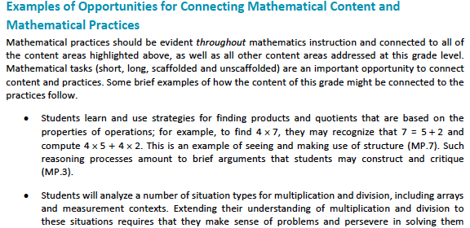
Grade 3 Example

Slide 20
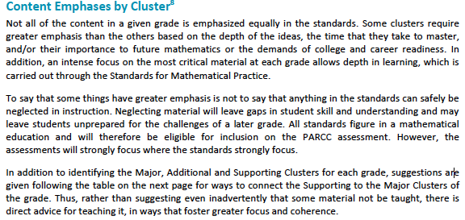
Grade 3 Example

Slide 21
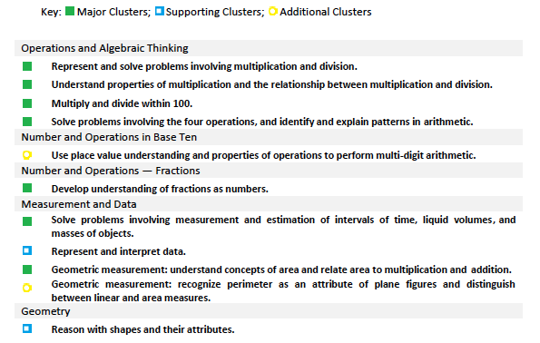
Grade 3 Example

Slide 22
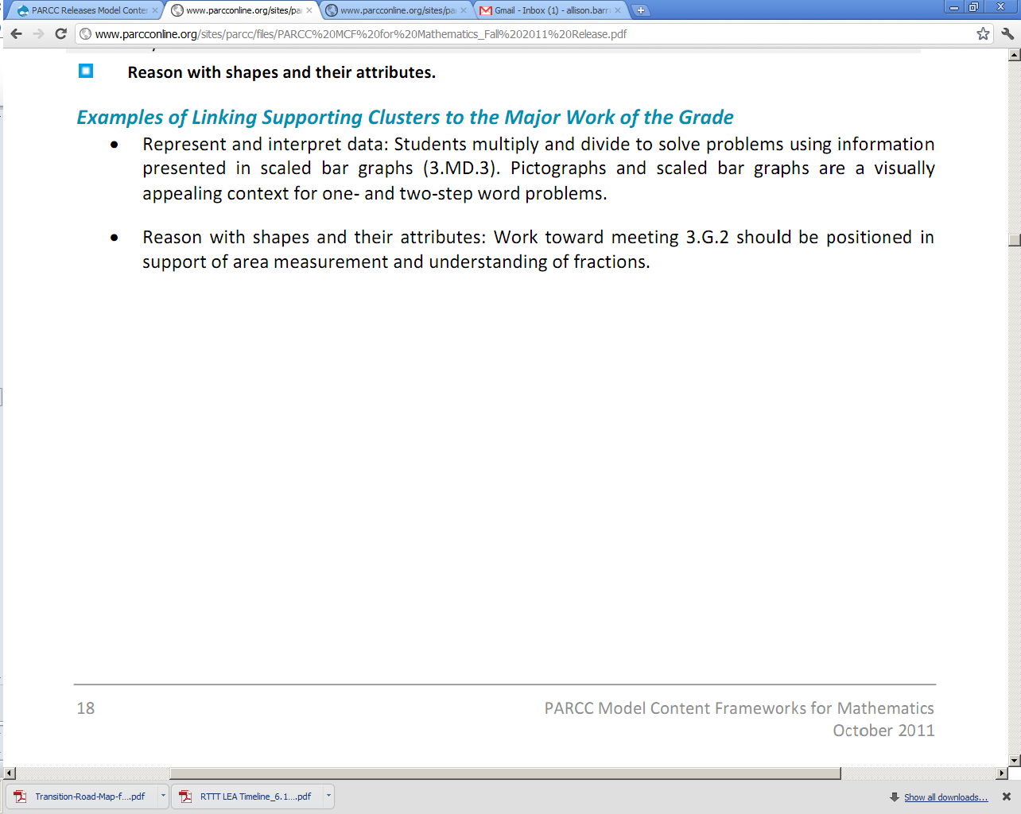
Grade 3 Example

Slide 23
Guidance for Mathematics
Supervisors and Teachers
Key advances in the standards between grade levels
Fluency expectations and major within-grade dependencies
Connections among standards, clusters, or domains
Opportunities for In-Depth Focus
Opportunities for Connecting Mathematical Content and Mathematical Practices
Notes:
There are many different ways Instructional Leaders in Mathematics can use the content frameworks as you begin to implement the standards into their instructional programs.
An important first step, after reading the standards themselves carefully, would be to read the introductory section of the Content Frameworks.

Slide 24
Guidance for Building Administrators
Using the content frameworks to guide discussions around implementation of the standards
Use the frameworks to support increased focus and coherence in instructional programs
Using the frameworks to gain a deeper understanding of the role of the practices in cooperation with the content, to support student learning
Notes:
As instructional leaders, it’s critical that building administrators understand the standards and how to facilitate dialogue across the school regarding standards implementation.
This can be used as a guide for you in framing conversations you begin and continue to have with building administrators around standards implementation.

Slide 25
Reflection Time
How would you use (or are you using) the Model Content Frameworks for Mathematics?
http://www.parcconline.org/parcc-content-frameworks

Slide 26
Coming Soon: More High School Specificity
High School Course Boundaries
  Development is in progress
  Feedback from the 24 participating PARCC states is happening now (April 16 – May 7)
  HS Course Boundaries are embedded in the HS Model Content Framework document
  Two Pathways
    Algebra I, Geometry, Algebra II
    Course I, Course II, Course III
Notes:
HS Course Boundaries are in development and are in draft form
NCSM Board Members are currently reviewing an early draft
These are embedded in the Model Content Frameworks document that will be out for Public Review in late May/early June
Encourage to be on the lookout for the public review

Slide 27
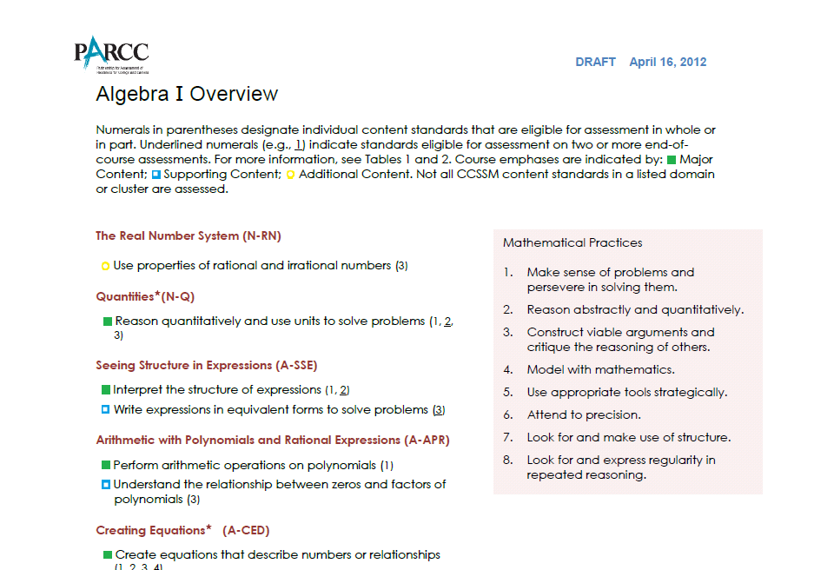
Coming Soon: More High School Specificity
Notes:
As with the 3 – 8 Content Frameworks, the Major, Supporting, and Additional Content is labeled.
There are a few things that still need to be worked out and are still under discussion, like where to place Probability and Statistics and whether or not to include the plus standards in this document.

Slide 28
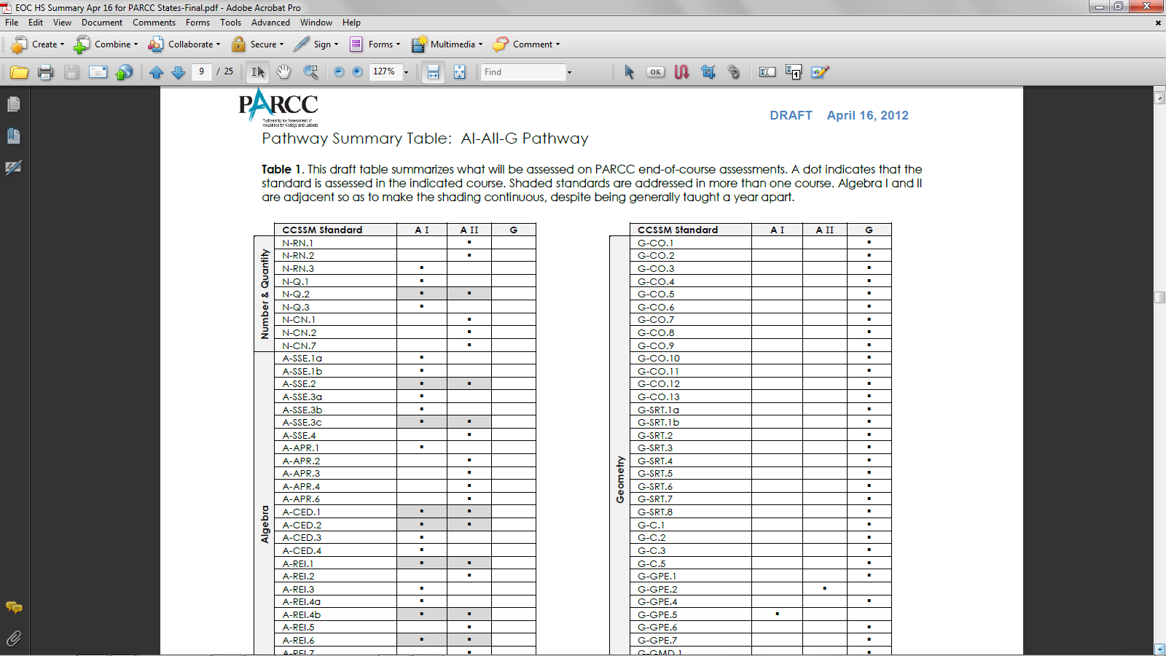
Coming Soon: More High School Specificity

Slide 29
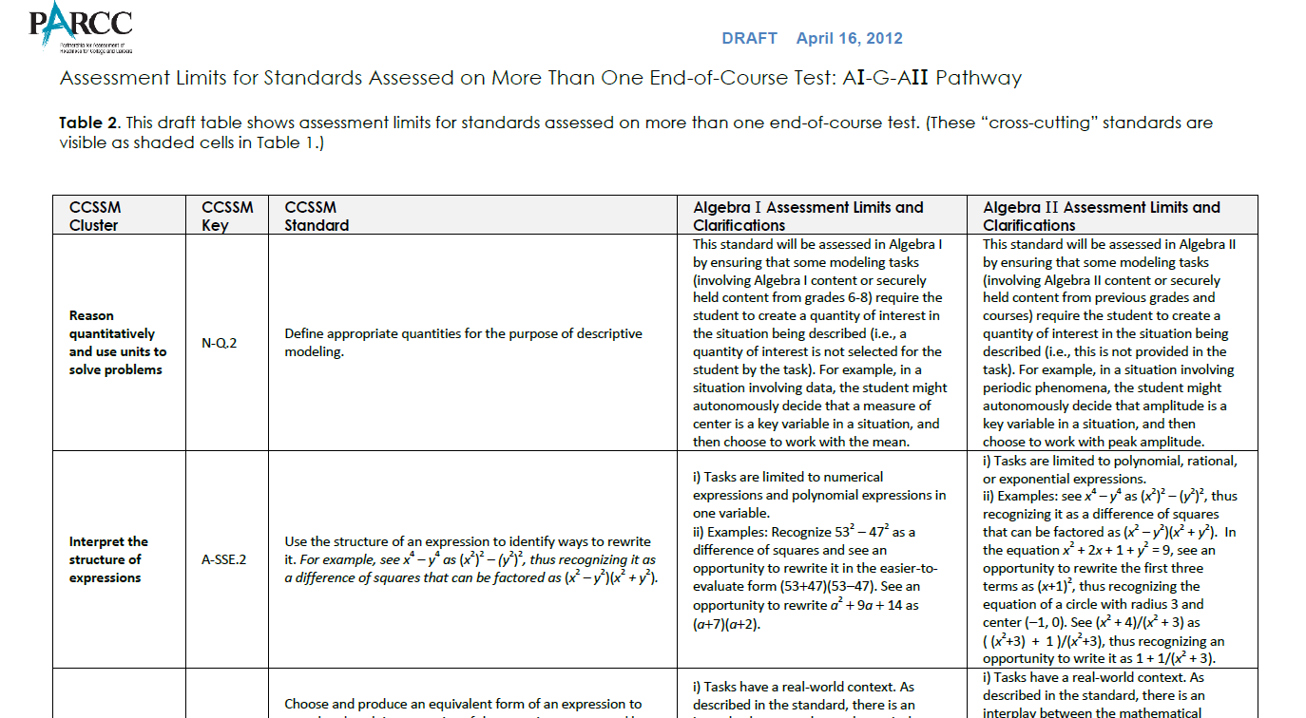
Coming Soon: More High School Specificity

Slide 30
Model Content Frameworks
Grades 3 – 8 and High School
  Public Review
  Coming Late May or Early June
  Focus on where educators feel the frameworks are not clear
  Focus on where more clarification would be helpful

Slide 31
Additional PARCC Mathematics Updates

Slide 32
PARCC Mathematics Highlights:
The Work is Underway
Prototype/Sample Items Update
  Round 1 of Prototyping
  Round 2 beginning
  June Public Release
    Public release of sample items
    Public feedback on sample items
Notes:
Prototype Items Update:
Work with the Dana Center to develop innovative items that can be release to the public and to the item development vendors
Round 1 items are currently being field-tested through the Dana Center
Work in progress and we continue to define and refine what it means to have innovative items
Round 2 development is beginning now and the Dana Center is using what they learned from round 1 to inform development for round 2
June Public Release:
PARCC will be releasing some sample items mid to late June
Items will show a variety of assessment shifts and content shifts
Initial release will be static, therefore we will not be able to show technology-enhanced items
Technology-enhanced items will come in a later release
Will be welcoming public comment on these items to help inform future item development

Slide 33
PARCC Mathematics Highlights:
The Work is Underway
Item Development Begins
  Item Development is beginning very soon
  More detailed assessment blueprints are in the process of being developed
  Kick-off meeting for item development – mid June
  State Core Leadership Team
Notes:
Very high level Assessment Blueprints were included in the Item Development ITN
More detailed assessment blueprints are in the process of being developed now
Kick-off meeting scheduled for mid-June. This will include item development vendors, achieve staff, and a core leadership team from states.
State Core Leadership Team have been (or are in the process of) being identified in each PARCC state. The state core leadership team will have a large role in reviewing assessment items developed by the vendors.

Slide 34
PARCC Mathematics
Do you have any questions or topics you would like to discuss?

Slide 35
PARCC Update
Mathematics
April 2012
Sign up for PARCC Place Newsletter and Updates at www.parcconline.org
Carrie Piper
Senior Adviser, PARCC Mathematics
cpiper@achieve.org

