Slide 1
Reviewing Three Act Tasks
“Analysis Tool”
www.mathedleadership.org
See presenter notes for goals, notes, and presenting moves.
Notes:
Summary: This power point can be used by mathematics education leaders to provide professional development for teachers that will prepare them to review and select Three Act Task to incorporate into their instruction.
Concept: Three Act Tasks are great modeling tools in mathematics.
Time: 45-60 minutes.
Materials: Three-act Analysis Tool and a Three Act Task to use as an example.
Note: This slide is not necessary for teachers to see.

Slide 2
Instructions
The analysis tool is meant to be used to review and select Three Act Task.
Each section should be considered after watching the corresponding act of the task.
The general characteristics should be considered after viewing all three acts.
Notes:
Goal: The goal of this slide is to give the teachers an overall idea of how the tool works.
Facilitator Notes
Pass out the “Analysis Tool”. Introduce it by saying something like, “This tool is a list of characteristics that high quality Three Act Tasks might have. Today, we are going to discuss how this tool might be used to review and select tasks to use in your classrooms.” Our goal here is to inform the teachers of the tool and encourage Three Act Tasks in the classroom.
Explain the steps of a Three Act Task. Make sure the teachers understand that a Three Act Task consist of three parts, Act I, II, and III. “We will be looking at qualities of each individual Act and also general characteristics.” If the teachers are unfamiliar with using Three Act Tasks in their instruction you may want to use the next slide to provide a brief introduction to this instructional strategy.
Explain how to use the Analysis Tool. “When using the tool, you will need to watch Act I and then consider the characteristics for Act I. Similarly watch and consider the characteristics for Act II and Act III. After viewing all three acts of the task, consider the characteristics for a Three Act Task in general.”

Slide 3
The Three Acts
Act 1 – The Prompt, The Main Questions and Investing in the Problem
Act 2 – The Information Gathering and Problem Solving
Act 3 – The Reveal
Notes:
Goal: Give a brief introduction to Three Act Tasks. This slide maybe omitted if the teachers are familiar with the Three Act Task instructional strategy.
Facilitator Notes
Some points that could be made about Act 1:
The students encounter a natural question quickly and visually.
The students encounter the question apart from the tools, information and resources necessary for answering it.
The students apply informal intuition to the question before formal operations.
Some points that could be made about Act 2:
The students decide what information they will need to solve the problem.
The students decide on the tools and resources they will need to solve the problem (CCSSM Practice 5).
The students made sense and persevere in solving the problem (CCSSM Practice 1).
Some points that could be made about ACT 3:
The students verify the answer to the question in the world itself.
The student considers the difference between the answer provided by the mathematical model and the answer in the world.

Slide 4
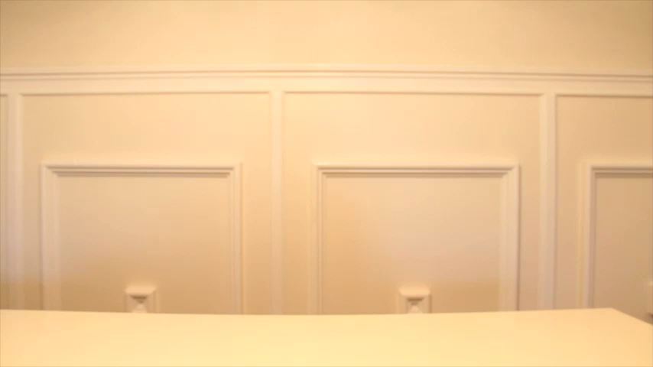
Act I
Notes:
Goal: The goal of this slide is to show Act I of Dan Meyer’s, “Yellow Starbursts.” This slide can be changed based on the task you and the teachers decide to review.
Facilitator Notes
Ask teachers to watch Act I of the Task. “We are going watch Act I of an example task so that we will have a context for discussing the characteristics that Act 1 might have.”

Slide 5
Act I
The task shows students an interesting, non-static event with an uncertain result!
What works :
Engaging media component
Multiple senses are incorporated
Students easily identify with the prompt
Text does not interfere with the prompt
Students naturally notice and wonder without prompting
Notes:
Goal: The goal of this slide is to discuss what “an interesting, non static event” means.
Facilitator Notes
Ask teachers to describe the action that takes place in the video. Would you describe what you just saw as non-static? Why or why not?
Ask teachers to consider the term “interesting” in the eyes of their students. “Do you feel intrigued by this video? Do you feel that your students would be interested? Does this video leave you wondering what the result is?”
Ask teachers to pair and share. “Share your thoughts on this statement with your neighbor. Does this prompt properly interest you, why or why not?”

Slide 6
Act I
The task allows students to forecast the behavior of the model.
What works:
Questions are measureable
The prompt drives the students towards the intended main question(s)
Notes:
Goal: The goal of this slide is to discuss the meaning of “forecast the behavior of the model”.
Facilitator Notes
Questions you might use are:
What questions are you thinking of after watching Act 1?
Are the questions measureable?
The intend questions for this prompt were: *How many of these packs will have exactly one
yellow Starburst? How many will have exactly two? To what degree do you think this prompt drives students toward the intended main question?
*This will depend on the task you are using during the professional development.

Slide 7
Act I
The task encourages the students to exercise proper estimation skills and compare them to others.
The task also allows the range of estimations to be broad.
Notes:
Goal: The goal of this slide is to discuss the importance of estimations in the a three act task instructional strategy.
Facilitator Notes
Some possible questions that might be discussed include:
Based on this prompt, do you think students will be able to make estimates (including high and low)?
If all the estimates are the same are close to the same, how might the level of student engagement be impacted?
How does estimating promote risk taking for students?

Slide 8
Act I
The task allows conflict to motivate students.
Notes:
Goal: The goal of this slide is to discuss how conflict in the prompt might motivate students.
Facilitator Notes
One possible discussion question might be:
In what ways does this prompt encourage students to persevere (want to know the answer)?

Slide 9
Act I
The task includes an information gap that delays the answer before giving a formula or information.
Notes:
Goal: The goal of this slide is to explain the importance of delaying the answer.
Facilitator Notes
Ask teachers to remember classes where students automatically blurt out the answer. “When students are immediately given the answer, they do not have time to process the problem and how to solve it. This hinders the learning experience. If one student blurts out an answer immediately, there are other students who never work the problem.”
Ask teachers to determine whether Act I of this task leaves an information gap. “Act I ends with selecting a question to pursue. Is there an information gap after Act 1 that allows for the students to think about what information they will need to answer the question? Is there an obvious need for more information?”

Slide 10
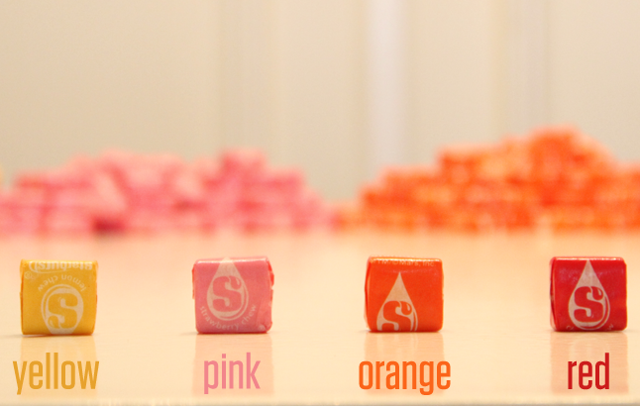
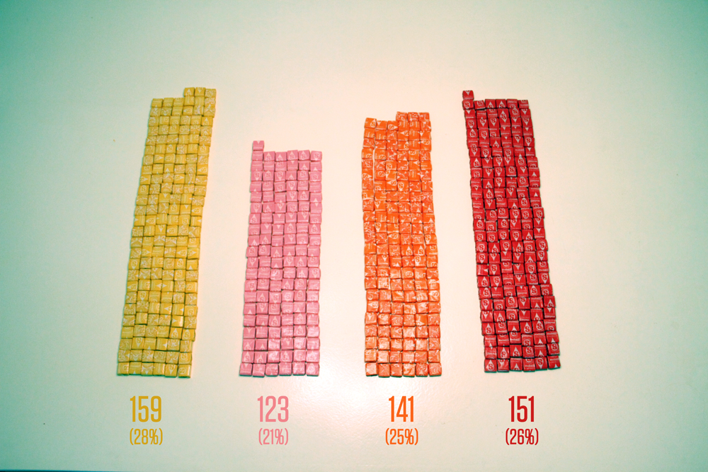
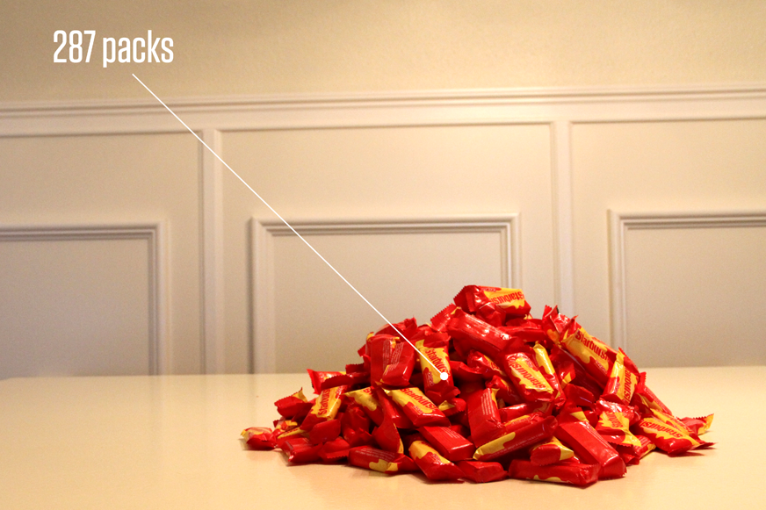
Act II
Notes:
Goal: The goal of this slide is to show Act II of the three act task. This act is where the information that students have asked for is supplied.

Slide 11
Act II
The task allows the students to make a list of information needed and identify variables on their own.
Notes:
Goal: The goal of this slide is to think about the importance of students identifying information that is needed and the variables in a problem.
Facilitator Notes
A possible discussion question might be:
Do you think students will be able to identify ALL the information they will need to answer this questions in this task?
Ask teachers to give only the requested information. “Allowing the students to take control of the needed information gives them ownership of the problem. Make a chart of needed information of the board and try to only give the information that the students have requested.” This requires good facilitation skills, they need to ask for the information that you plan to provide in Act 2;
Ask teachers to let students recognize variables. “Let the students acknowledge all variables: known and unknown and values that co-vary.”

Slide 12
Act II
The task finalizes and gives needed information.
Notes:
Goal: Discuss the degree to which Act 2 finalizes and gives needed information.
Facilitator Notes
Possible discussion questions might include:
Does the information given in the task over-scaffold the mathematics for the students?
Does the information given in the task make the mathematics and a solution path obtainable by students?
Is too much information given in the task?

Slide 13
Act II
The task has a checkpoint, a place in the problem where you can get an answer to an intermediate step to make sure you understand what’s going on and make necessary corrections before the problem is over.
Notes:
Goal: The goal of this slide is to prompt a discussion of the importance of a task having a checkpoint in Act 2.
Facilitator Notes
Discussion questions might include:
Is there an opportunity in Act 2 of this task to get an answer to an intermediate step to make sure the students understand what is going on and make the necessary corrections before the problem is over?
How does having a checkpoint improve the lesson quality?

Slide 14
Act II
The task encourages patient problem solvers and leads to student improving their decisions.
Notes:
Goal: Consider the importance of patient problem solving.
Facilitator Notes
Ask teachers to write their definition of patient problem solving. Have them share their definition with a partner. Have someone share their definition with the whole group. Ask what others would add to the definition.
Considering the task we are examining, how would you say it encourages patient problem solving?
How might this task lead student to improve on their mathematical decisions?

Slide 15
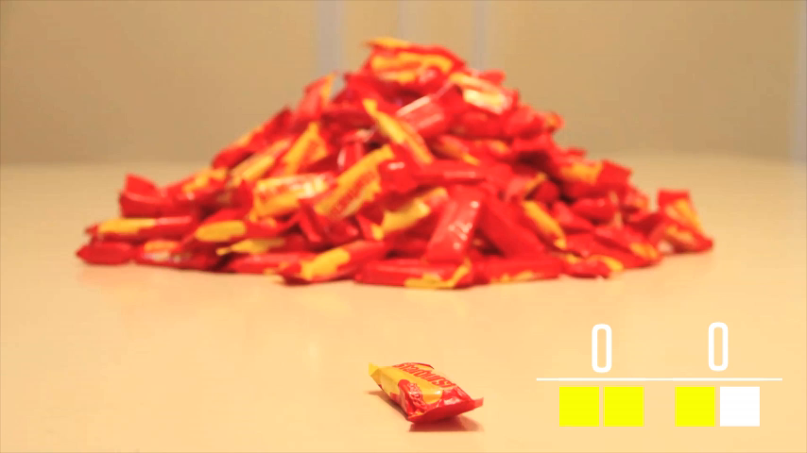
Act III
Notes:
Goal: The goal of this slide is to show Act Three of the three act task.

Slide 16
Act III
The task has a Act 3 that shows the answer visually so that students may check their results .
Notes:
Goal: The goal of this slide is to ensure the task has a definite answer in Act III.
Some possible points:
If the answer remains theoretical, the lesson will not have the same effect.
Students with answers different from the one revealed, provide opportunities for learning.
Discussion question might be:
Does the task we are examining show the answer visually and allow student to compare their results to the result shown?

Slide 17
Act III
The task lets the student determine whether or not the model describes the system accurately.
Notes:
Goal: The goal of this slide is to consider the degree to which a mathematical model describes the system accurately.
Facilitator Notes
Possible points include:
Some problems get an exact answer, others will never be exact, but hope to be close.
Sometimes there is not one right answer because of the assumptions made about the variables.
Discussion question:
To what degree does the task we are examining allow student to determine whether or not the model describes the system accurately?

Slide 18
Act III
The task sets the stage for the next topic or extension lesson.
Is there an Act 4?
Notes:
Goal: The goal of this slide is to support the value of extensions and connections in the task?
Facilitator Notes
What are some possible extension for the lesson we are examining? What are the next topics after this lesson? How would this lesson “fit” in the learning trajectory?

Slide 19
General
The task is relevant and meaningful at the student's grade level - There is a need for this task.
Notes:
Goal: The goal of this slide is to confirm the relevance of a task.
Facilitator Notes
Giving information to students who do not believe the information is important is a waste of time. The task must make the students feel as if the answer is relevant to them. The proper relevance of a task will vary by class and age.
Is the mathematics in the task we are examining relevant and meaningful for students?
Is the mathematics in the task “important”? What does it mean for mathematical concept to be “important” to you?

Slide 20
General
The task, along with appropriate teacher facilitation, leads to students recognizing and understanding important mathematical concepts.
Notes:
Goal: The goal of this slide is to confirm the need for teachers to see improvement in student understanding.
Facilitator Notes
Ask teachers to use the task as a tool. “A high quality three act task is a tool that connects the math to a real world topic. This should lead students to acknowledging the connections and consequently grasping important concepts.”
One way to determine what students have learned from the task is to ask them to name the task in such a way that the mathematical concept is evident. How might your students name this task to convey the “important” mathematics they used in the task?

Slide 21
General
The task depicts reality by telling a story including an engaging introduction, information, and a conclusion.
Notes:
Goal: The goal of this slide is to explain the task as a story.
Facilitator Notes
Ask teachers to view each act as a part of a story. “ The entire task should tell a story. Act I of the task should be an intriguing introduction followed by Act II, the information, and Act III is the finale.”
Ask teachers to identify the steps of the story in the example task. “What is the engaging introduction, information, and conclusion of this task?”

Slide 22
General
The task includes multimedia, encourages intuition, asks short questions, lets students do and allows teachers to be less helpful.
Notes:
Goal: The goal of this slide is to introduce Dan Meyer’s five essential elements of a proper mathematical model.
Facilitator Notes
Ask teachers to consider all five steps. “A proper mathematical model should consist of a video, picture and/or music. It will promote students’ instinct to solve it and allow room for several questions. In addition, a proper model will let the students discover and do more work while the teacher guides the instruction.”

Slide 23
General
The task reaches a level four on the Depth of Knowledge (DOK) criteria.
Level 4 – Extended Thinking
Requires an investigation, time to think and process multiple conditions of the problem.
Notes:
Goal: Connect DOK criteria to the task.
Facilitator Notes
Does this task reach a level 4 on DOK criteria?

Slide 24
General
The task “turns the real world into math” and “turns math back into the real world”.
Notes:
Goal: The goal of this slide is to insist on the significance of exploration.
Facilitator Notes
Ask teachers to implement exploration. “Does this task allow room for exploring different consequences? Is there more than one way to solve the problem?”
*Allowing students time to explore on their own is crucial to the learning experience.

Slide 25
Disclaimer
It is not necessary for one task to contain all of these components. It would be rare to find a task with all characteristic listed in the tool!
Notes:
Goal: The goal of this slide is to let the teachers know that all tasks will not contain all of the characteristics on the list to the same degree. The characteristics listed are designed to help teachers make thoughtful decisions when selecting tasks.

Slide 26
Project Contributors
Reviewers:
Dane Ehlert
Graham Fletcher
Robert Kaplinsky
Dan Meyer
Jon Orr
Kyle Pearce
Michael Wiernicki
Undergraduate Researcher:
Jamie Mullins
Notes:
Thank you to the project contributors.

