Slide 1

File Cabinet
Andrew Stadel
See presenter notes for goals, notes, and teaching moves
Notes:
Summary: Students are going to find how many sticky notes will cover the 5 visible sides of the cabinet.
Concept: Surface area of rectangular prisms.
Standard: 6.G.4; 7.G.6; MP.4.
Time: 45 minutes.
Materials: Three-act handout.
Note: This slide is not necessary for students to see.

Slide 2
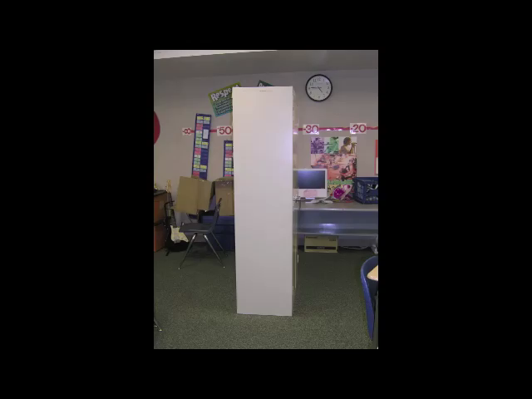
Notes:
Goal: The goal of this slide is to establish the context of the problem and pose the task: “How many sticky notes will it take to cover the file cabinet?”
Teaching Moves
Play the video. Introduce it by saying something quick and informal like, “Here’s a video I thought was interesting.” Avoid announcing mathematical objectives or academic vocabulary at this stage. Our goal here is to keep the task concrete and intuitive. [Why? #1]

Slide 3
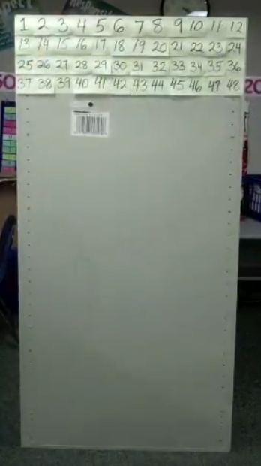
What is your guess? Share your guess with your neighbor and say why you think it is.
Notes:
Goal: The goal of this slide is to ask students to apply their intuition and guess an answer. After this slide, students may want to know which of them guessed correctly.
Teaching Moves
Ask students to write down guesses. Say, “Would you please write down on your handout the number of sticky notes that will cover the file cabinet? [Why? #2]
Ask students to pair and share. Say, “Share your guess with your neighbor. Do you both agree? Do you disagree?” [Why? #4]
Take a class-wide poll of guesses. Ask for some students to share their guesses with the whole class. Write down a handful of the guesses on the board. [Why? #5]
Interesting Outcomes
The students will need to know how many faces will be covered. They can’t accurately guess the number of sticky notes that will cover the file cabinet without crucial information. Have student pair and share a guess about the number of faces of the file cabinet. Tell students that five faces will be covered, then ask for their guesses for the total number of sticky notes.
The class is divided. The video intends to engage students. The ideal outcome has the class with a wide range of answers. You may want to discuss why some answers are too small or others are too big. [Why? #6]

Slide 4
What information would be useful here? How would you get it?
Notes:
Goal: The goal of this slide is for students to see that the dimensions of both the cabinet and sticky notes are necessary. Furthermore, it might prove useful for students to know which sides are being covered with sticky notes; the four vertical sides and the top. The bottom will NOT be covered.
Teaching Moves
Ask students what information is important. Ask, “What information would be useful here and how would you get it? Would you write down some ideas for yourself on your handout?” [Why? #7]
Ask students to pair and share. Say, “Share your ideas with your neighbor. Do you both agree? Do you disagree about what’s necessary?” [Why? #4]
Make a list of information requested. Ask students to share the information they want. Write suggestions on the board next to the owner’s name or type them in a document, depending on which is faster for you. But record everything. The goal here isn’t to pass judgment on good and bad suggestions. It’s to collect student ideas. There’s no need to collect every student’s idea, though. Once you’ve recorded a broad cross-section of the class’ ideas, cut the process short. [Why? #10]
Push students for precision. See the interesting outcomes below and how you might respond. As you pull and tug on certain students’ responses, put a star or some mark next to the suggestion to illustrate that you’ve addressed it. It isn’t necessary to address all of them. This is a chance to redirect students to more precise mathematical vocabulary. For example, some teachers would start a lesson by introducing the vocabulary. However we didn't, so when students say, "We need to know how long each side is" teachers can say something, "When we are talking about prisms, we call each side a “face” and how long they are depends on measuring the height, width, and depth of the rectangular prism.”
Interesting Outcomes
Students ask how many sticky notes go up down the cabinet. Take this one first. Say something like, “Great idea. That’d be so easy, and we could all get out of here for break. But unfortunately all I’m working with at the moment is a measuring tape.”
Students ask for some extremely precise information. For example, “How many sticky notes are on each pad?” “How many sticky notes will cover the front face?” “What’s the area and perimeter of the cabinet?” It may seem initially that these students are being disruptive or disagreeable but every other student ought to emulate this attention to precision. Answer these questions directly and with sincerity, then throw a lot of praise on them.

Slide 5
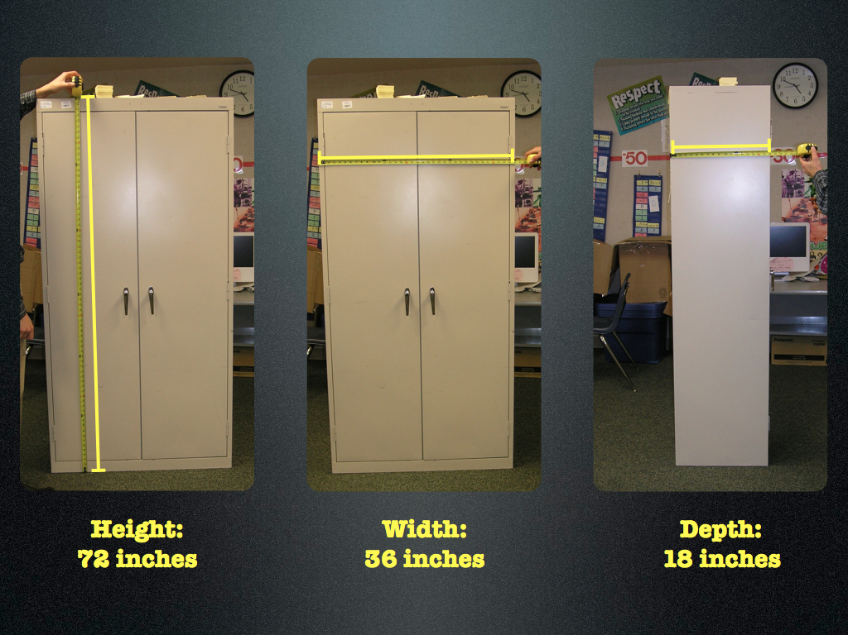
Notes:
Goal: The goal of this slide is to give students the information you’ve settled on as most precise and easiest to measure with the tools on hand, all without implying a specific solution strategy yet. The goal of this slide is that students struggle productively so that they crave more information so they can know what to do with this information before you teach them a formula for surface area.
Teaching Moves
Ask students to estimate. Show students the first measurement by clicking once through the slide. Say, “Now that you know this one dimension of the file cabinet. I need you to guess the others.” [Why? #3]
Ask students to pair and share their guesses. On the share out, ask for a show of hands “if anyone has ##.anything, ##.anything, ##.anything, etc.” Then show the answer and ask the class to give one clap to the group that had the closest estimate.

Slide 6
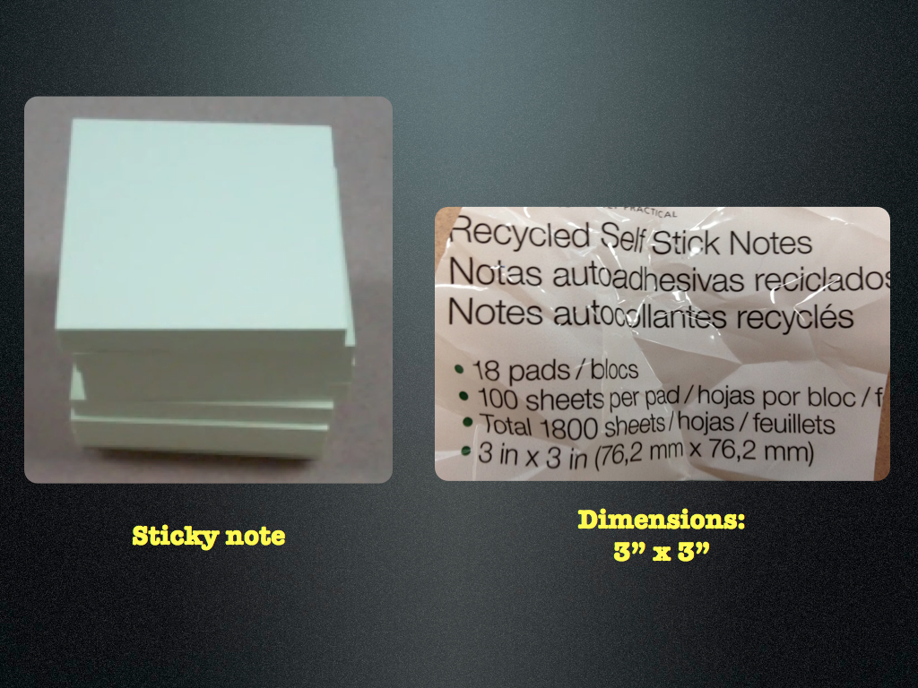
Notes:
Goal: The goal of this slide is to give students the information you’ve settled on as most precise and easiest to measure with the tools on hand, all without implying a specific solution strategy yet. The goal of this slide is that students struggle productively so that they crave more information so they can know what to do with this information before you teach them a formula for surface area.
Teaching Moves
Give students some time to struggle. Say, “Okay, you guys asked for this information because you had some rough, fuzzy plan for it. I want you to take a minute to work on your own and put that plan into action.” [Why? #11]
Ask students to share ideas with their neighbors. Don’t expect your students to just “discover” the formula for surface area. Don’t expect all this understanding to arise without some intervention on your part. If students invest time and struggle in the question, they’ll want the explanation even more and be in a better place to appreciate it. [Why? #4]
Interesting Outcomes
Students don’t solve the problem. In this case we’ll move to the lecture in the next slide.
Some students solve the problem. This is always a possibility. If a student solves the task quickly, pose one of the extension questions we’ve included in later slides.

Slide 7
Notes:
(This slide is intentional left blank)
Goal: The goal of this slide is for students to work on possible solutions. See student work for possible solutions.

Slide 8

How do you find the
Surface area of a rectangular prism?
Notes:
Goal: The goal of this slide and the next is to help students to develop a strong concept of “surface area” and particularly surface area of prisms.
Teaching Moves
Explain how to find the surface area of a rectangular prism. Important steps here may include a) pointing out that it took 12 sticky notes (3”x3”) to go across the width (36 inches) of the file cabinet; b) reminding students that the area rectangle is length times width; c) asking students to see that each vertical face can be doubled since it’s opposite face is congruent.
Ask students to record those ideas somewhere useful (notebook or journal) for later. Hold students accountable for knowing the meaning of vocabulary.
If you, as the teacher, has another way of helping students conceptually understand surface area of a prism, it can be substituted here.

Slide 9
1
2
3
4
5
6
7
8
9
10
11
12
36 inches
How do you find the
Surface Area of a rectangular prism?
Notes:
Goal: The goal of this slide and the previous one is to help students to develop a strong concept of “surface area” and particularly surface area of prisms.
Teaching Moves
Explain how to find the surface area of a rectangular prism. Important steps here may include a) pointing out that it took 12 sticky notes (3”x3”) to go across the width (36 inches) of the file cabinet; b) reminding them that the area rectangle is length times width; c) asking students to see that each vertical face can be doubled since it’s opposite face is congruent.
Ask students to record those ideas somewhere useful (notebook or journal) for later. Hold them accountable for knowing the meaning of vocabulary.
If you, as the teacher, has another way of helping students conceptually understand surface area of a prism, it can be substituted here.

Slide 10
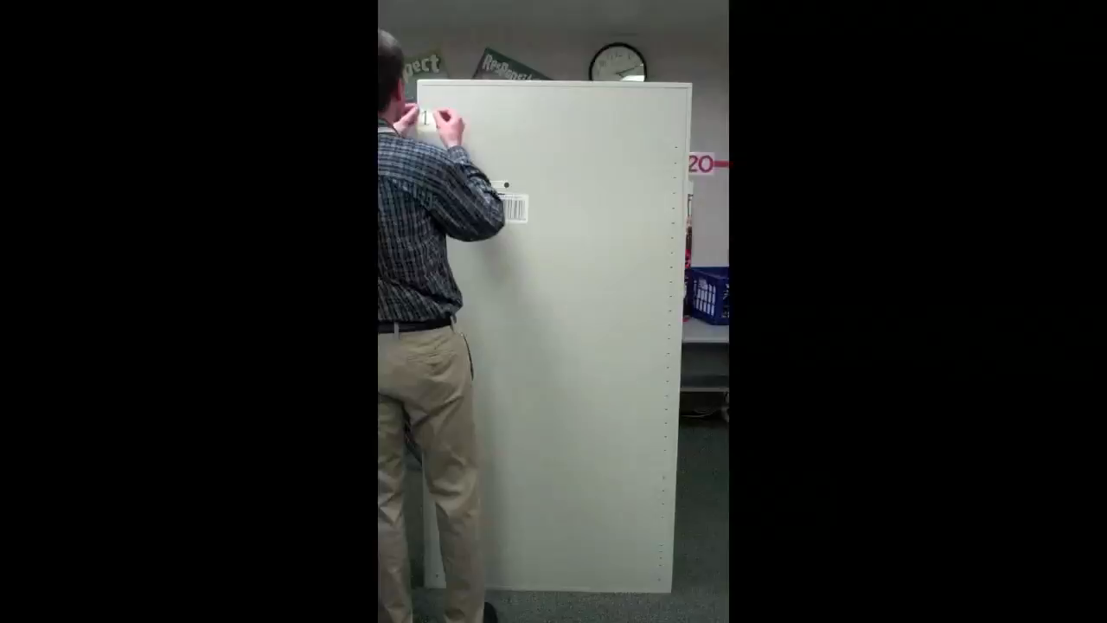
Notes:
Goal: The goal of this slide is to verify that mathematics is a functional model for describing/predicting the world. [Why? #8]
Teaching Moves
Discuss mathematics as a model. Say, “The math shows that the file cabinet should be covered with 936 sticky notes (see student work). But turning the world into mathematics isn’t always a super precise process. It can result in some error. Let’s find out how close we were.”
Give status to students who guessed correctly. Ask the students to examine their original guesses.

Slide 11
Extension Tasks

Slide 12
Extension 1
If you had 1,000,000 sticky notes, what kind of file cabinet could they cover?
Notes:
Goal: The goal of this slide is to extend the mathematics already discovered/learned. Use this for early finishers or after the whole class has completed Act 3.
Teaching Moves
Have students map out as many possible cabinet dimensions as possible. Encourage students to work backwards through the algorithm to discover the dimensions.

Slide 13
Extension 2
If each dimension of the file cabinet was doubled, how many more sticky notes would you need?
Notes:
Goal: The goal of this slide is to extend the mathematics already discovered/learned. Use this for early finishers or after the whole class has completed Act 3.
Teaching Moves
Have students map out as many possible cabinet dimensions as possible. Encourage students to work backwards through the algorithm to discover the dimensions.

Slide 14
What is the title of our lesson?
Notes:
Goal: The goal of this slide is to formalize the mathematics and make sure students know the point of their work. [Why? #9]
Teaching Moves
Ask students to title the lesson. Say, “Would you all take a minute and write down a title for our lesson that is true to the math we did and what we used the math for?”
Ask students to pair and share. Ask them to share their responses with each other.
Ask students to share out their titles if they want. This is just so students can flex their creativity for a brief moment and so you can see what students pulled out of the experience.

Slide 15
Using the Math of Surface Area and Rectangular Prisms to Cover a Cabinet with Sticky Notes
Notes:
Goal: The goal of this slide is to tell students what we were trying to teach with this lesson.
Teaching Moves
Share your own title. The author’s title is, “Using the Math of Surface Area and Rectangular Prisms to Cover a Cabinet with Sticky Notes.” You can create your own, of course, but make sure it includes both the context (covering a cabinet with sticky notes) and the mathematics (surface area of rectangular prisms). Make sure the students write down your title alongside theirs.

Slide 16
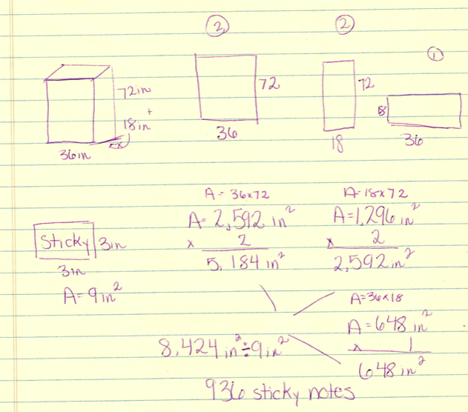
Student Work
Notes:
Goal: The goal of this slide is to show student work and solution strategies.
Teaching Moves
Share student work. Compare the work of your students to the work here.

Slide 17
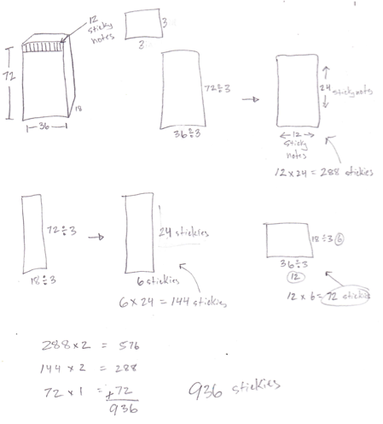
Student Work
Notes:
Goal:
The goal of this slide is to show student work and solution strategies.
Teaching Moves:
Share student work. Compare the work of your students to the work here.

