Slide 1
Thirsty Values
Linda Griffith and Jamie Mullins
See presenter notes for goals, notes, and teaching moves
Notes:
Summary: Students are going to discover how many CapriSun pouches are left on the table using place value.
Concept: Place Value
Standard: CCSS.Math.Content.1.NBT.C.4
Time: 30 minutes.
Materials: Three-act handout.
Note: This slide is not necessary for students to see.

Slide 2
Notes:
Goal: The goal of this slide is to establish the context of the problem and eventually settle on wanting to know, “How many pouches are there all left on the table?”
Teaching Moves
Play the video. Introduce it by saying something quick and informal like, “Here’s a video that looks fun.” Avoid announcing mathematical objectives or academic vocabulary at this stage. Our goal here is to keep the task concrete and intuitive.

Slide 3
What are some mathematical questions that come to mind after watching the video?
Notes:
Goal: The goal of this slide is to establish the context of the problem and pose the task: “How many pouches are left on the table?”
Some of the questions students might pose are:
“How many Caprisuns are placed on the table at the beginning?”
“How many pouches are in each box?”
“How many pouches did the students take off the table?”
“How many pouches are left at the end?”

Slide 4
How many pouches are left on the table?
What is your guess? Write it on a sticky note and post it on the number line.
Notes:
Goal: The goal of this slide is to ask students to apply their intuition and guess an answer. After this slide, students may want to know which of them guessed correctly.
Teaching Moves
Take a class-wide poll of guesses. Start by guiding the students to a boundary, guesses that are too high and guesses that are too low. Ask for some students to share their guesses with the whole class. Use the highest and lowest guesses to create a number line.
Ask students to write down guesses. Say, “Would you please write down on a sticky note the number of pouches you think are left on the table?”
Ask students to walk to the board and place their sticky notes on a number line. “Share your guess on the number line.”
Make a list of information requested. Ask students to share the information they want. Write suggestions on the board next to the owner’s name.
The goal here isn’t to pass judgment on good and bad suggestions. It’s to collect student ideas. There’s no need to collect every student’s idea, though. Once you’ve recorded a broad cross-section of the class’ ideas, cut the process short.
Push students for precision. See the interesting outcomes below and how you might respond. As you pull and tug on certain students’ responses, put a star or some mark next to the suggestion to illustrate that you’ve addressed it. It isn’t necessary to address all of them.
Need to Know:
The students need to know how many CapriSun boxes were put on the table. This number will include the box that was opened and dumped onto the table.
The students will need to know how many pouches of CapriSun are in each box. They can’t accurately guess the number of drinks that are on the table without crucial information. Have students pair and share a guess about the number of drinks in each box.
They also need to know how many pouches of CapriSuns are taken off of the table. Allow time for the students to quickly pair and share or popcorn answer this question.
The class should be divided. The video intends to engage students. The ideal outcome has the class with a wide range of answers. You may want to discuss why some answers are too small or others are too big.

Slide 5
There were 12 boxes of CapriSun placed on the table.
Notes:
Goal: The goal of the next 3 slides is to give students the information you’ve settled on as the necessary tools to solve the problem.
Teaching Moves
Give students some time to struggle. Say, “Okay, you guys asked for this information because you had some rough, fuzzy plan for it. I want you to take a minute to work on your own and put that plan into action.”
Ask students to share ideas with their neighbors.
Ask students what other information is important. Ask, “What other information would be useful here and how would you get it? Would you write down some ideas for yourself on your handout?”
Interesting Outcomes
Students don’t solve the problem. In this case we’ll discuss more strategies and use “the art of questioning.”
Some students solve the problem. This is always a possibility. If a student solves the task quickly, pose one of the extension questions we’ve included in later slides.

Slide 6
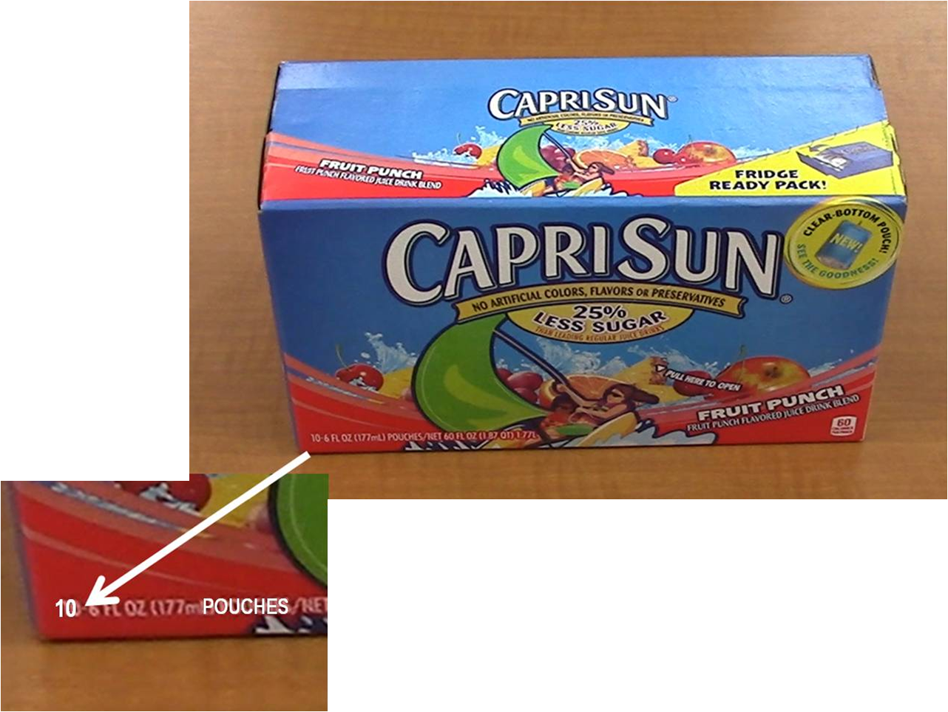
Notes:
Goal: The goal of the next 3 slides is to give students the information you’ve settled on as the necessary tools to solve the problem.
Teaching Moves
This would be a good time to introduce math terms.

Slide 7
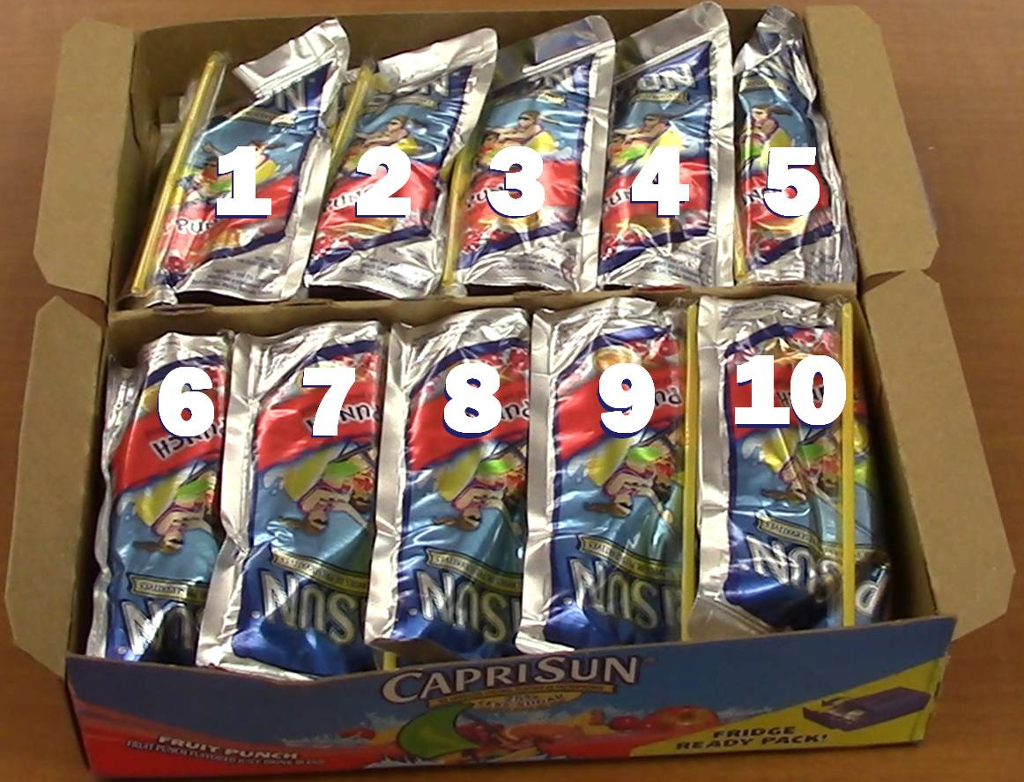
Notes:
Goal: The goal of this slide is for students to see that the number of pouches in each box in addition to the number of boxes are both necessary to get an accurate answer. Furthermore, it might prove useful for students to know how many kids come in and take a drink.

Slide 8
Notes:
Goal: The goal of this slide is for students to understand that they also need the number of pouches taken off of the table to get an accurate answer.

Slide 9
Notes:
(This slide is intentional left blank)
Goal: The goal of this slide is for students to work on possible solutions. See student work for possible solutions.

Slide 10
Notes:
Goal: The goal of this slide is to show the students each box in groups of 10 and loose pouches.
Teaching Moves
Announce to the students “We will begin counting them by 10’s”
Move to the next slide to show counting!

Slide 11
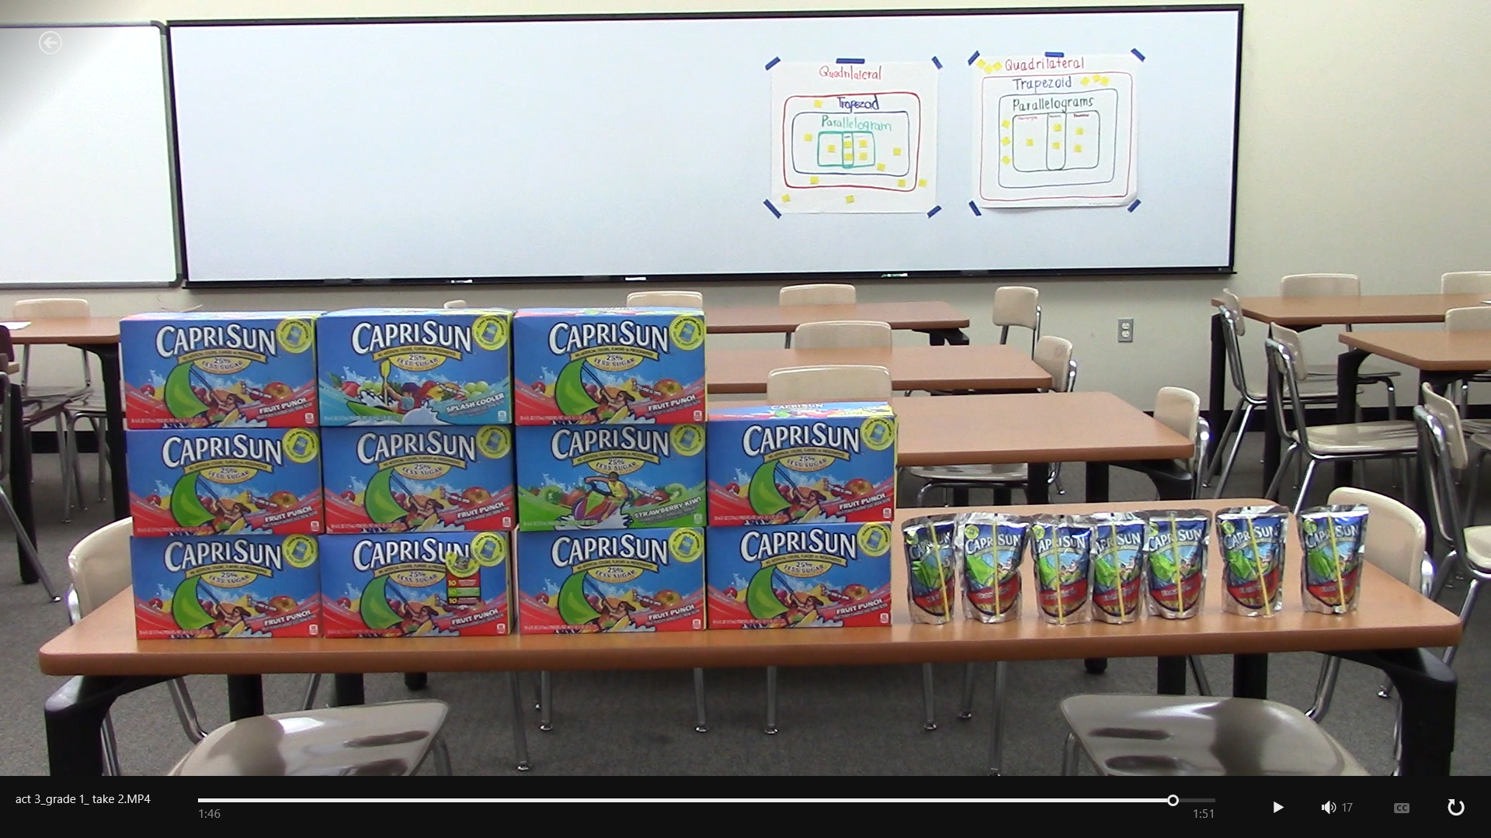
30
40
90
20
50
80
100
10
60
70
110
111
113
115
117
112
114
116
Notes:
Goal: The goal of this slide is to confirm that the students have reached the correct answer or the correct approach to solving the problem.
Teaching Moves
Ask students to share thoughts. Could they do this again with a different problem?

Slide 12
Extension Tasks

Slide 13
Extension 1
If you had 85 students, how many boxes of CapriSun would you need to buy so that each student has a drink?
How many extra would you have?
Notes:
Goal: The goal of this slide is to extend the mathematics already discovered/learned. Use this for early finishers or after the whole class has completed Act 3.
Teaching Moves
Have students create their own problem. Encourage students to work backwards through the algorithm to discover different strategies to solving the problem.

Slide 14
Extension 2
If I put 8 boxes of CapriSun into an ice chest and gave 6 pouches away before school, how many pouches would I have left in the ice chest?
Notes:
Goal: The goal of this slide is to extend the mathematics already discovered/learned. Use this for early finishers or after the whole class has completed Act 3.
Teaching Moves
Have students create their own problem. Encourage students to work backwards through the algorithm to discover different strategies to solving the problem.
Bring CapriSuns to class in an ice chest. Change the numbers on this slide according to how many boxes and students you have. This would allow students to physically interact and see the solution.

Slide 15
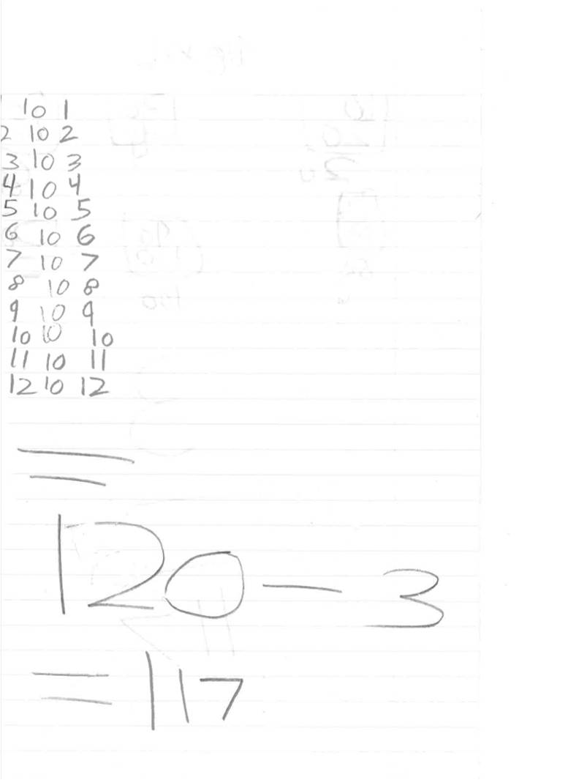
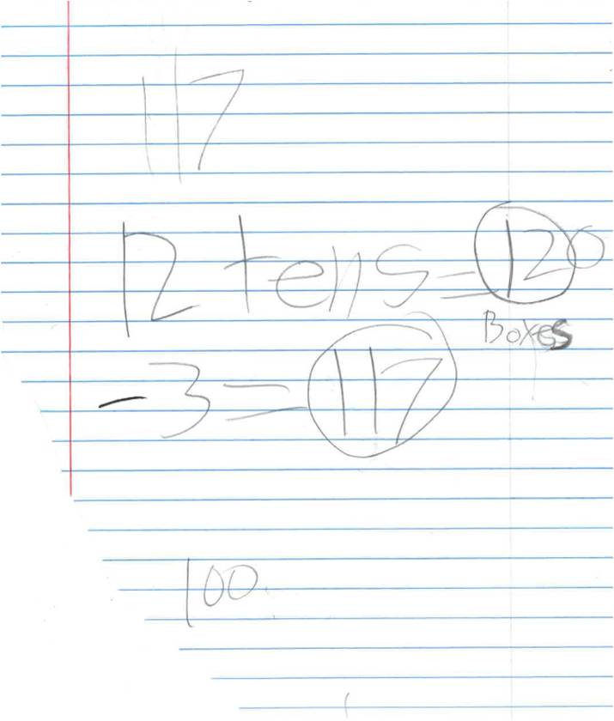
Student Work
Notes:
Goal: The goal of this slide is to show student work and solution strategies.
Teaching Moves
Share student work. Compare the work of your students to the work here.

Slide 16
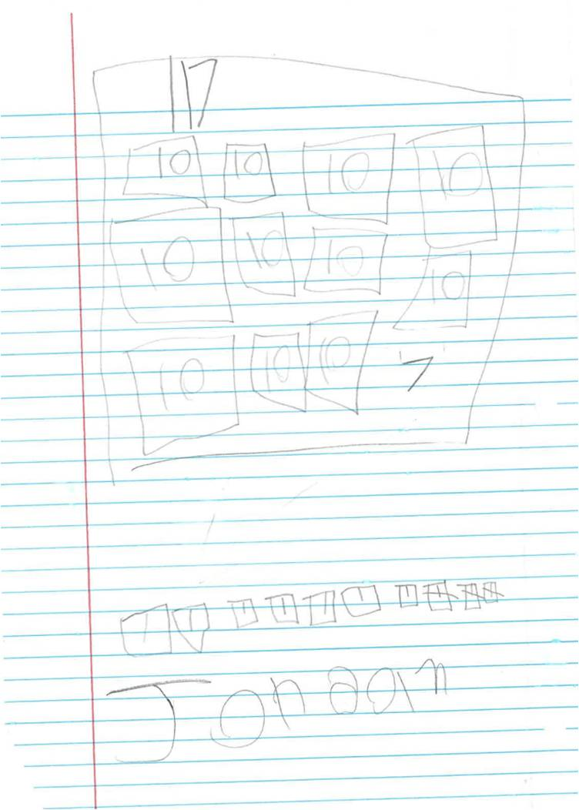
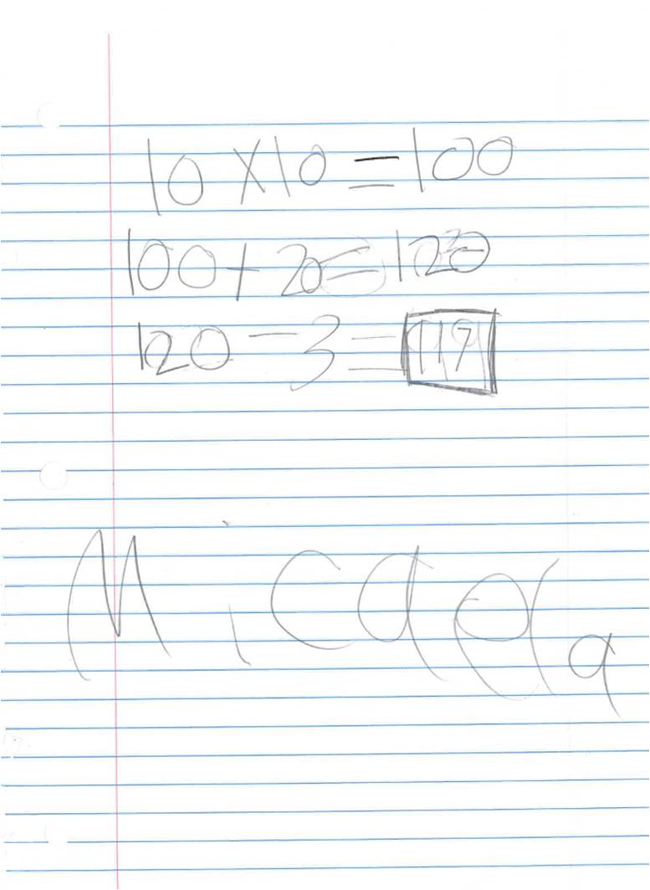
Student Work
Notes:
Goal:
The goal of this slide is to show student work and solution strategies.
Teaching Moves:
Share student work. Compare the work of your students to the work here.

